Slide 1

Cyber Defense Organization
Fall 2018 - Intro to Cloud Security

Slide 2

Agenda:
Word of the Week
What is the “Cloud”?
Types of cloud services and cloud providers?
AWS
Open up AWS, and go to the management console
Creating the virtual pentest lab with Kali and *Ubuntu.
Messing with IAM and creating a real life example “datajanitor”
Looking at AWS GuardDuty
Reading CloudTrail
Closing thoughts

Slide 3
Word of the Week
Body Area Network
A body area network (BAN) is the interconnection of multiple computing devices worn on, affixed to or implanted in a person’s body. A BAN typically includes a smartphone in a pocket or bag that serves as a mobile data hub, acquiring user data and transmitting it to a remote database or other system.

Slide 4
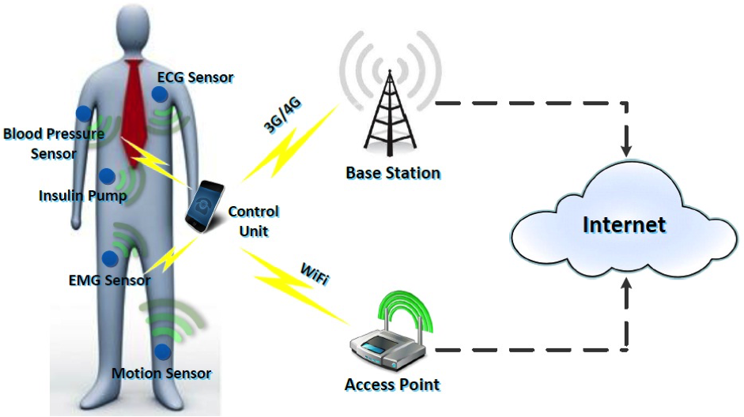

Slide 5
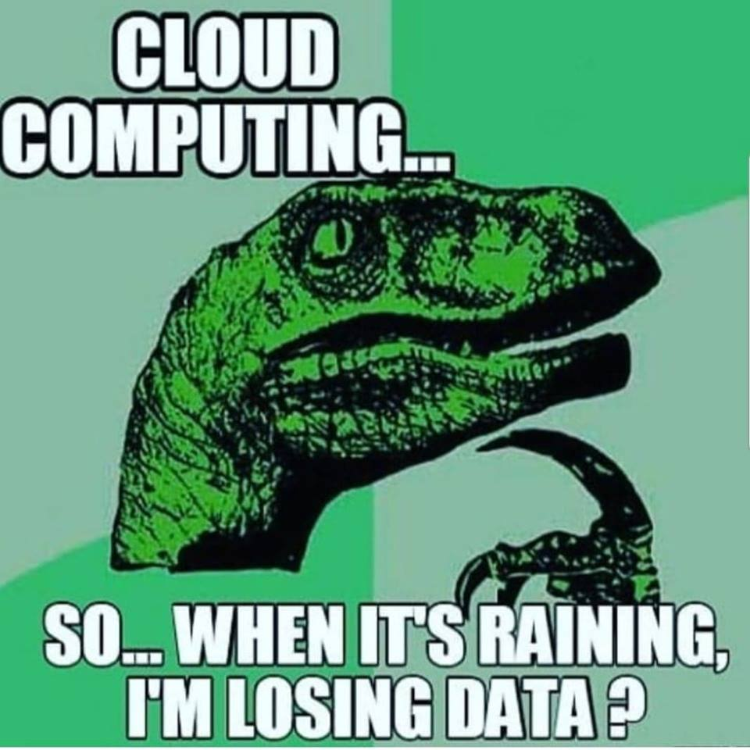
What is a “Cloud”
Cloud computing is taking services ("cloud services") and moving them outside an organization's firewall. Applications, storage and other services are accessed via the Web. The services are delivered and used over the Internet and are paid for by the cloud customer on an as-needed or pay-per-use business model.

Slide 6
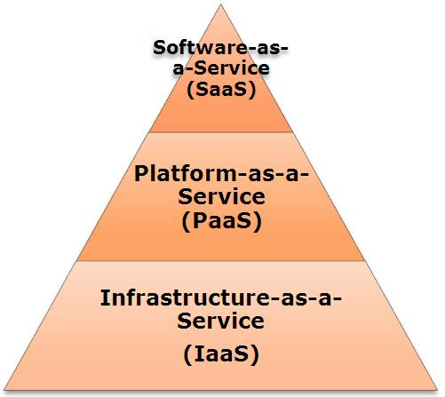
Types of Cloud Services

Slide 7
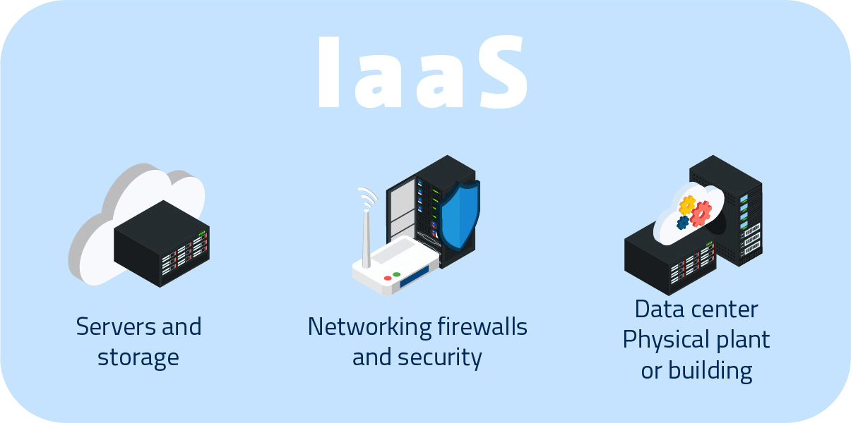
Iaas (Hardware)
You’re base, the physical stuff.

Slide 8
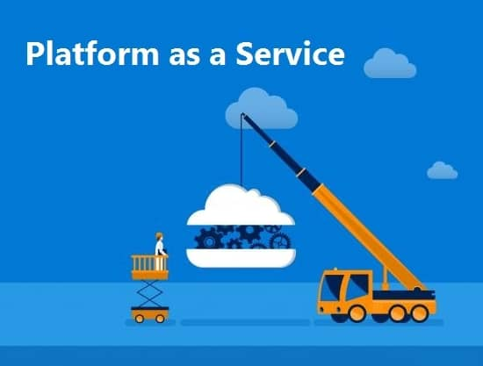
PaaS
Geared towards Software Developers
The application stack of the Infrastructure
“Middleware”
A placeholder for your php or javascript.

Slide 9
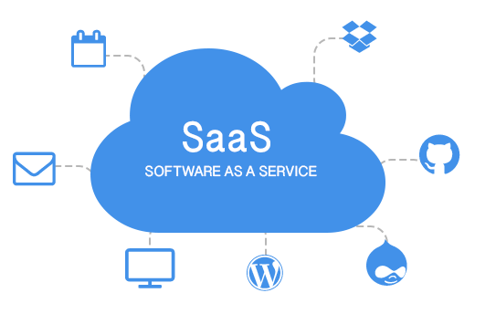
SaaS
For the End User (Customers)
Google Docs..
Application for you delivered over the internet.
OS-agnostic, you can access it anywhere.

Slide 10
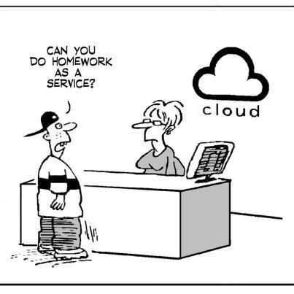
Other types of Services
CaaS - Communication as a Service
DaaS - Data as a service
XaaS - Anything as a service

Slide 11
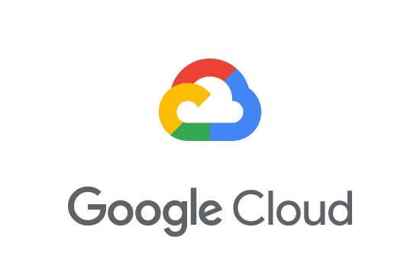
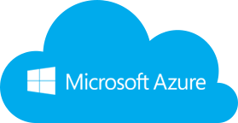
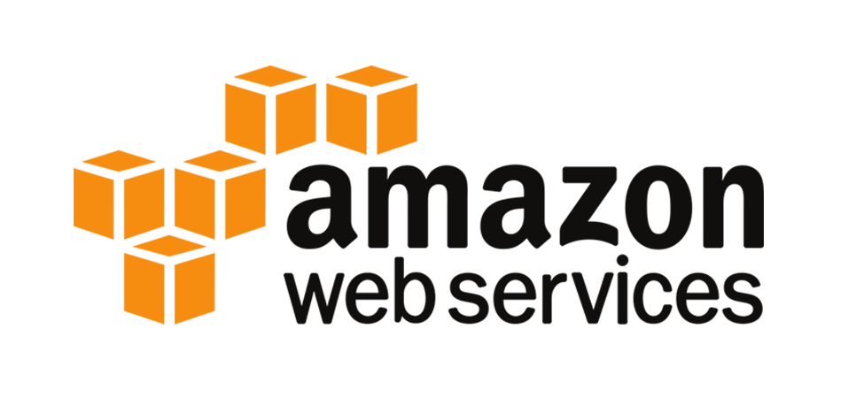
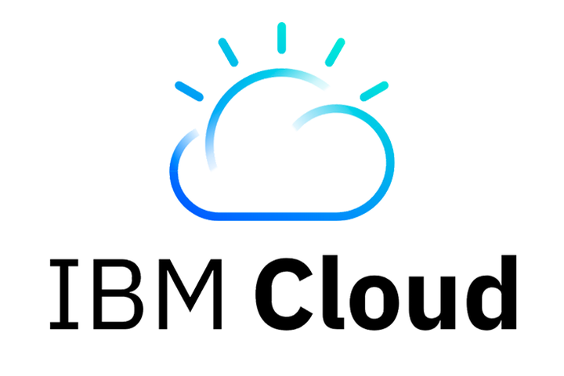
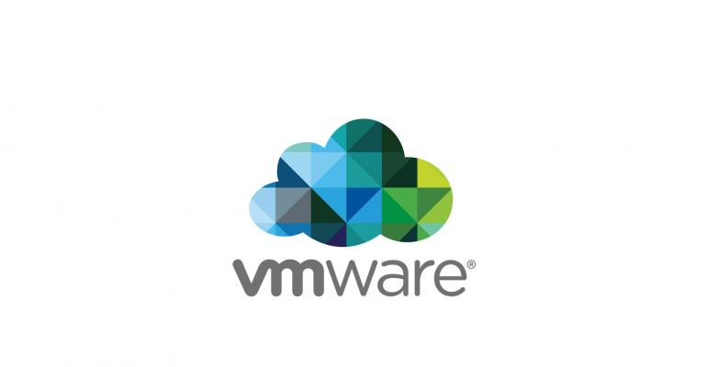

Top Cloud Providers

Slide 12
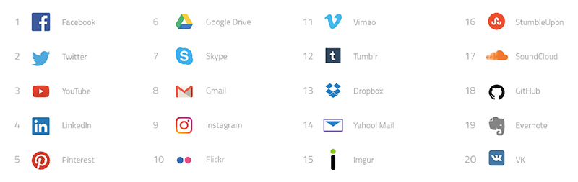
Who uses the Cloud?

Slide 13
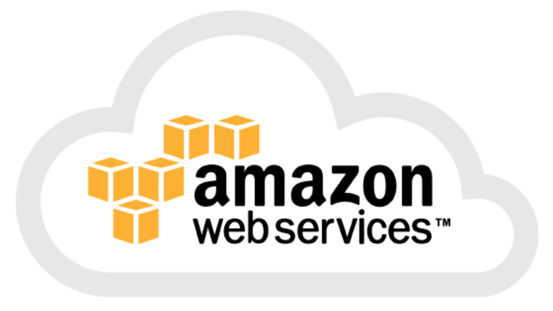
So, what’s the big deal with AWS?
-The AWS platform was launched in July 2002, but maybe you are just hearing of it now?
-Do you like Netflix?
- In regards to Security, the CIA offered 600 Million dollars to Amazon to create VPC’s and host private network’s for their data in July 2014.
- As of 2017, AWS owns a dominant 34% of all cloud (IaaS, PaaS) while the next three competitors Microsoft, Google, and IBM have 11%, 8%, 6% respectively according to Synergy Group

Slide 14

Questions?

Slide 15
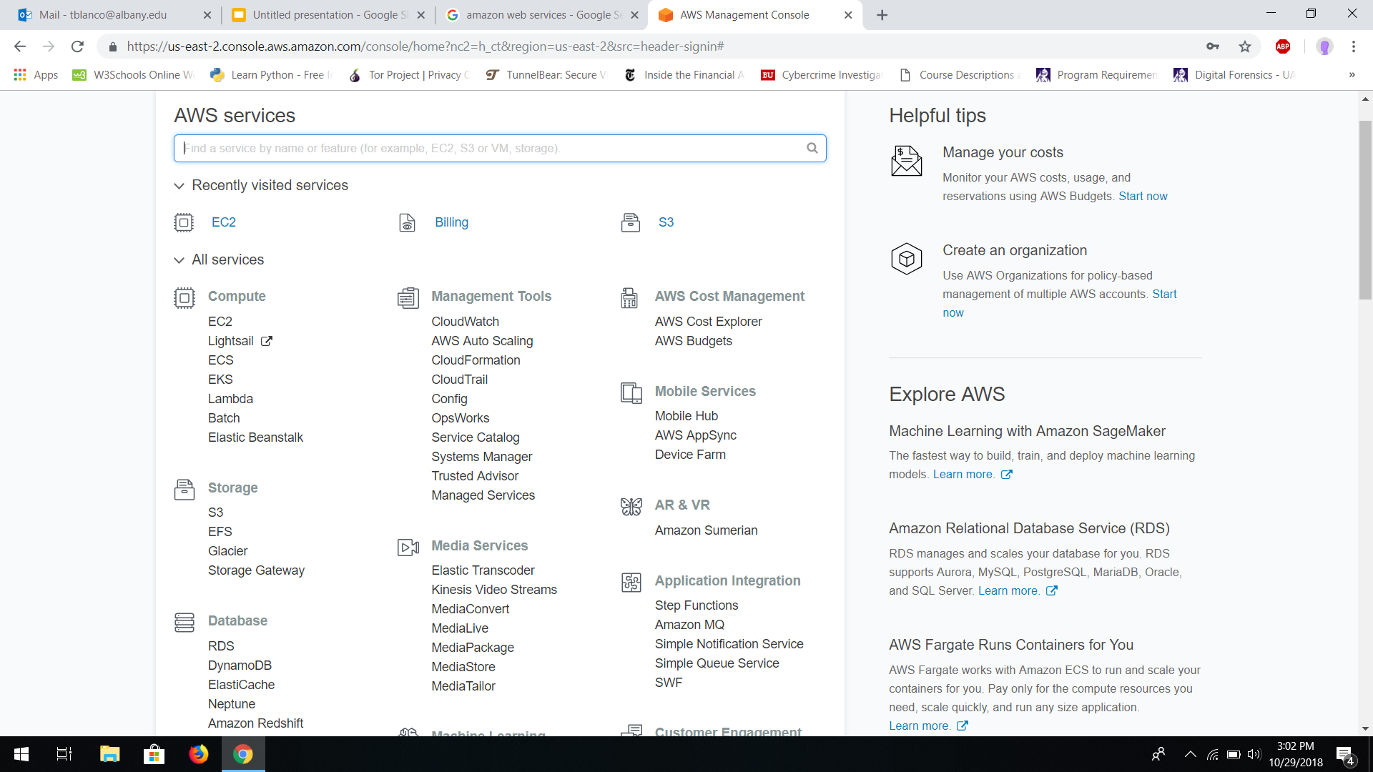
AWS MANAGEMENT CONSOLE

Slide 16


Pentest Lab with EC2 Instances
VS

Slide 17

IAM (Work-Place Scenario)

Slide 18

AWS GuardDuty

Slide 19
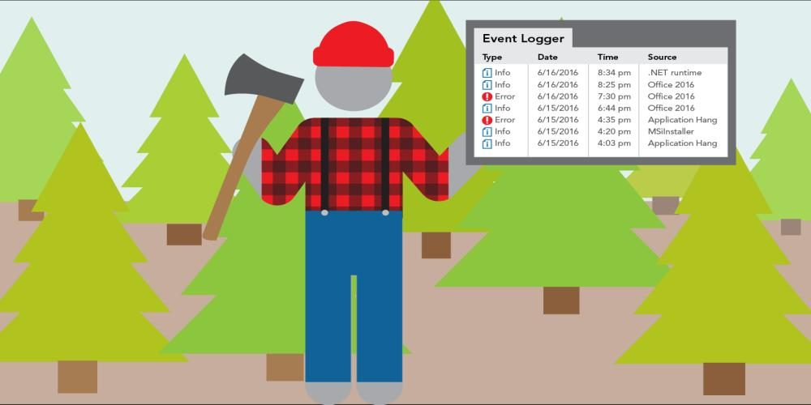
AWS CloudTrail

Slide 20
What did we cover?
❖ Amazon EC2 (Launching AMI’s and Working with Security Groups, Creating a virtual penetration testing lab utilizing Kali Linux AMI & Ubuntu Custom AMI, Explaining Key Pairs)
❖ IAM (Creating Policies, Users, Groups, Logging in with Alias/Link)
❖ Amazon GuardDuty (Analyzing Sample Entries, Severity rating and understanding metadata of threats)
❖ CloudTrail (Auditing and analyzing logs)

Slide 21
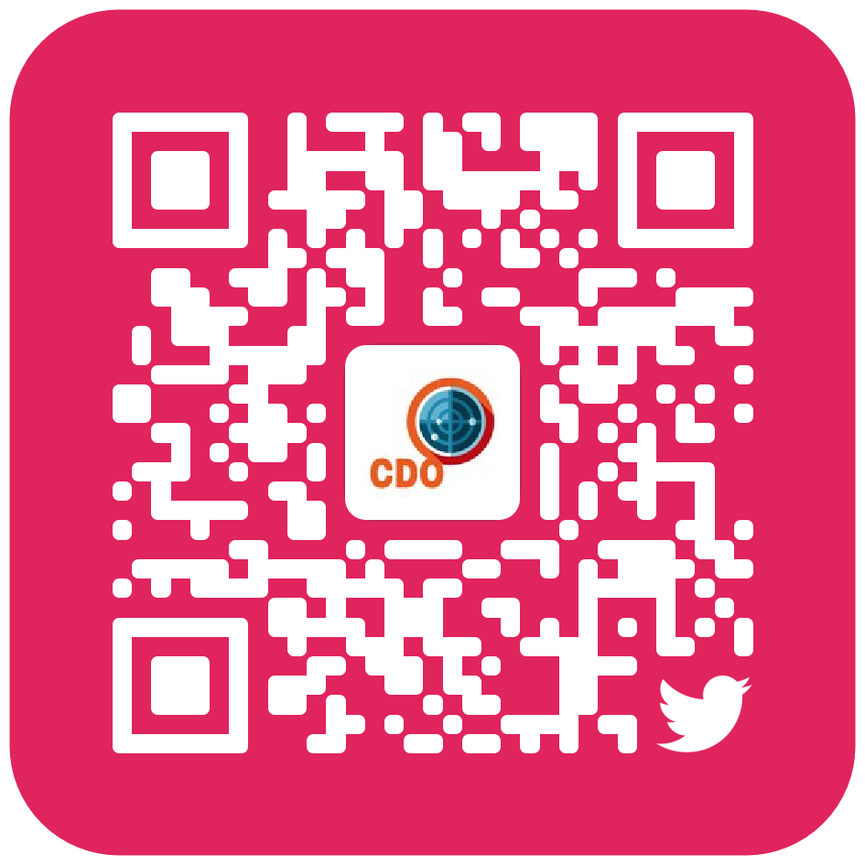
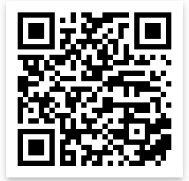
Cya Next week!
Thank you for participating in our workshops
Follow us on Twitter? Add on myInvolvement?
Join our Discord Group?
End of the semester Pizza Party, 3:00pm Next Friday (12/7)

